Slide 1
An evaluation of the use of covariate constrained randomisation for stepped-wedge cluster randomised trials
Caroline Kristunas, Laura Gray, Fan Li, Karla Hemming

Slide 2
Introduction
Stepped-wedge cluster randomised trials (SW-CRTs) often only randomise a small number of clusters.
Simple randomisation (SR) may struggle to balance cluster-level prognostic factors across intervention and control conditions.
The benefits of covariate constrained randomisation (CCR) for parallel CRTs has been investigated and may be beneficial for SW-CRTs.

Slide 3
Objectives
Use simulation to extend the work conducted by Li et al. for parallel CRTs to SW-CRTs by:
Comparing the power and maintenance of the type I error rate for CCR to SR
Under different SW-CRT designs (different number of sequences and number of clusters randomised to each sequence)
Under different values of the intracluster correlation coefficient (ICC)
As the candidate set size for the CCR is changed
Under an adjusted and unadjusted analysis model
Li F, Lokhnygina Y, Murray DM, Heagerty PJ, DeLong ER. An evaluation of constrained randomization for the design and analysis of group-randomized trials. Statistics in medicine. 2016 May 10;35(10):1565-79.

Slide 4
Methods – data generation
Data were generated from the following linear mixed effects model:
For an SW-CRT with K clusters, randomised to T-1 sequences, with a cluster-period size m. $z_{i}^{T}\sim Bernoulli(0.3)$ were four binary cluster-level covariates, with coefficient vector $γ=2_{4×1}$, $θ$ the treatment effect fixed at 0 to assess the type I error rate and 0.31 (sd 2) to assess power, $X_{ij}$ the treatment indicator for the $i^{th}$ cluster in the $j^{th}$ period, $α_{i}\sim N(0,σ_{b}^{2})$ the random cluster effects, $β_{j}=0$ the fixed time effect, $ε_{ijk}\sim N(0,σ_{e}^{2}=4)$ the error term. The ICC$=ρ=\frac{σ_{b}^{2}}{σ_{b}^{2}+σ_{e}^{2}}=0.01, 0.05, 0.1$.
For the following four SW-CRT designs:

Slide 5
Methods – selection of a randomisation scheme
Simple randomisation:
Select a randomisation scheme at random from the entire randomisation space.
Covariate constrained randomisation:
Identify prognostic cluster-level covariates
Use a balance metric to score the balance of each randomisation scheme in the randomisation space with respect to the covariates of interest
Order the randomisation schemes by their balance score
Take a proportion of the schemes with the lowest scores to form a candidate set of schemes (e.g. 1%, 5%, 10%, 20%, 50%)
Randomly select a randomisation scheme from the candidate set of schemes.

Slide 6
Methods – analysis of the trial
A linear mixed model with a random effect for cluster and fixed effect for time was used to analyse the trials under the selected randomisation scheme.
For randomisation schemes selected under SR, the adjusted analysis models included between 1 and 4 of the covariates as a fixed effect.
For randomisation schemes selected under CCR, the adjusted analysis models included a fixed effect for each of the covariates that were balanced in the CCR.
A Satterthwaite small sample correction was used.
The lme function from the nlme R package was used to conduct all analyses.

Slide 7
Methods – estimation of power and type I error
The process of selecting a randomisation scheme and analysing the resulting trial was repeated 10,000 times under each randomisation method, SW-CRT design, ICC, candidate set size and analysis method.
The proportion of false positives and true positives were calculated and reported as Monte Carlo type I error rate and power.

Slide 8
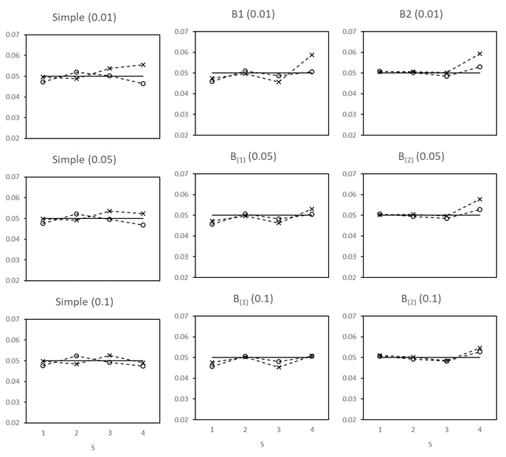
Results – type I error rate
Generally well maintained under an unadjusted analysis and under an adjusted analysis when not all the covariates were adjusted for. Generally well maintained for larger values of the ICC.
Inflated when all four of the covariates were adjusted in the analysis (both under SR and CCR), particularly when the ICC was small and when the candidate set size was small under CCR.
Design 1
16 clusters, 5 periods, 4 sequences, cluster-period size = 20,
candidate set size = 10% (2000)

Slide 9
Results – power
When all four covariates were adjusted in the analysis and the ICC was small, the type I error rate was inflated, these findings are therefore disregarded.
When the analysis did not adjusted for all four of the covariates, the adjusted and unadjusted analyses, and SR and CCR had similar power.
When all four covariates were adjusted in the analysis there was greater power than the unadjusted analysis and the CCR had slightly greater power than SR, particularly when the candidate set size and ICC were small.
Design 1
16 clusters, 5 periods, 4 sequences, cluster-period size = 20,
candidate set size = 10% (2000)

Slide 10
Summary
Unlike for parallel CRTs, it was not necessary to adjust the analysis of SW-CRTs for all of the covariates that were balanced in the randomisation in order to maintain the type I error rate.
However, when the ICC and candidate set size were small CCR provided a small improvement in power over SR.

Slide 11
Limitations
The average power investigated here is unable to demonstrate the potential benefit of CCR, in removing the possibility of selecting those schemes with the worst balance and poor power, which may be selected under SR.
The small sample correction used here may not perform well for SW-CRTs, or when the analysis is adjusted for covariates.

Slide 12
Thank you
Kristunas et al. SCT 2020

